Slide 1
Update: Proposed Creedmoor WWTP
Tom Reeder Division of Water Resources

Slide 2
SGWASA
SGWASA = South Granville Water & Sewer Auth.
Provides water & sewer service to south Granville County, Stem, Butner, and Creedmoor
Population served in 2012: 19,000 (approx.)
Wastewater Treatment Plant in Neuse Basin
Permitted capacity: 5.5 million gallons per day
Average Use: 1.9 million gallons per day
Maximum Use: 4.3 million gallons per day (1day/ 2012)

Slide 3
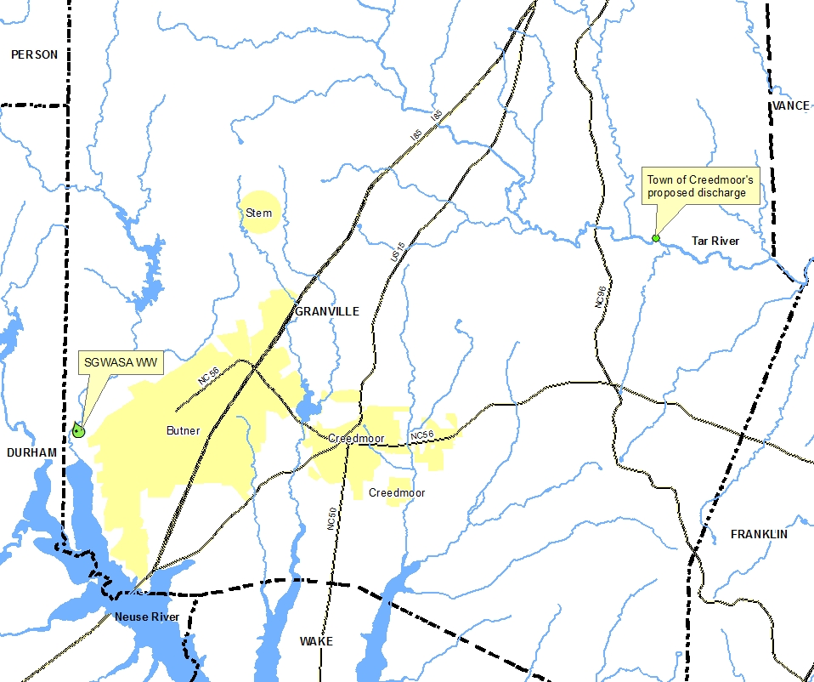

Slide 4
Background – Creedmoor Wastewater
Currently discharges to South Granville Water and Sewer Authority (SGWASA)
Have proposed 1.15 million gallon per day (MGD) wastewater plant
Discharge to Tar River in Granville Co.
To be funded by US Department of Agriculture (USDA)
Submitted National Environmental Policy Act (NEPA) Environmental Assessment document (1/2013)
Received speculative limits from DWR (3/2013)
Purchased land for project (5/2013)

Slide 5
NEPA Environmental Assessment Document Deficiencies
Documentation of population to be served so as to justify 1.15 MGD flow requirement
Potential exacerbation of turbidity impairment of Tar River downstream
Impacts to endangered species (Dwarf Wedge Mussel, River Harperella)
Impact of redirection of Neuse watershed flow from Falls Lake Reservoir
Documentation that SGWASA cannot accept wastewater (SGWASA has stated it can accept wastewater)
Notes:
SGWASA has publically stated that they have capacity in a letter to USDA

Slide 6
Current Status
No “Finding of No Significant Impact” (FONSI) from USDA
No NPDES permit application submitted
Notes:
This is the bottom line. Conceivably could end presentation here.

Slide 7
Steps Needed to Move Forward
Resolve Environmental Assessment deficiencies
Receive Finding of No Significant Impact (FONSI) from USDA
Apply for and obtain any necessary Clean Water Act Section 401 Water Quality Certifications and Section 404 Permits
Apply for and obtain NPDES discharge permit
Notes:
DWR has not received any further communication from Creedmoor or USDA since submitting comments on initial EA (March 2013).
USDA has indicated “informal discussions” proceeding (phone conversation with Tom Belnick)

Slide 8
Contact Information
Tom Reeder
Director, NC Division of Water Resources
919-707-9027
tom.reeder@ncdenr.gov

